Slide 1
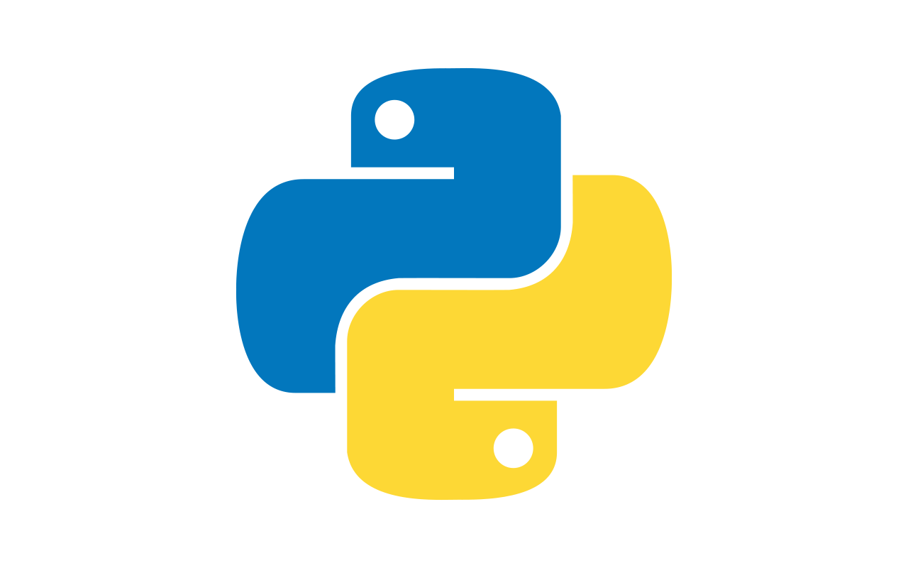
Welcome to the Bitcoin center’s
Python Academy

Slide 2
What is programming?

Slide 3
What is a program?

Slide 4
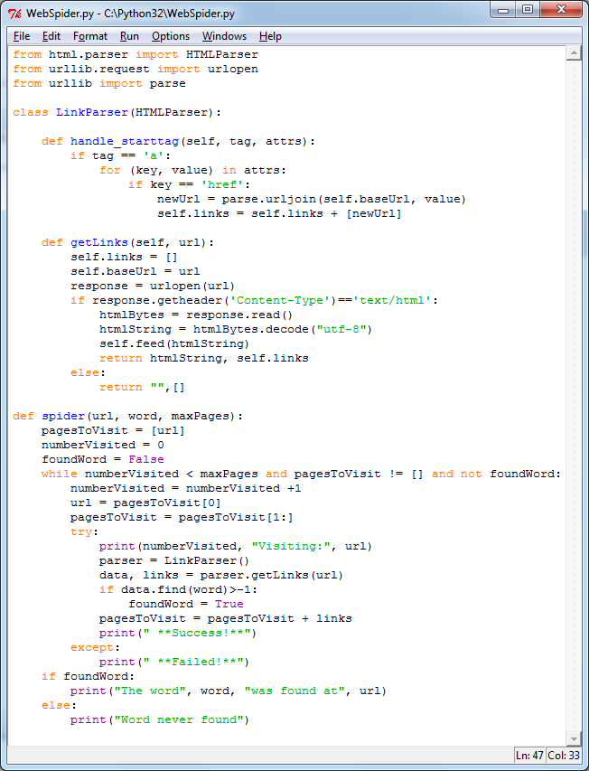
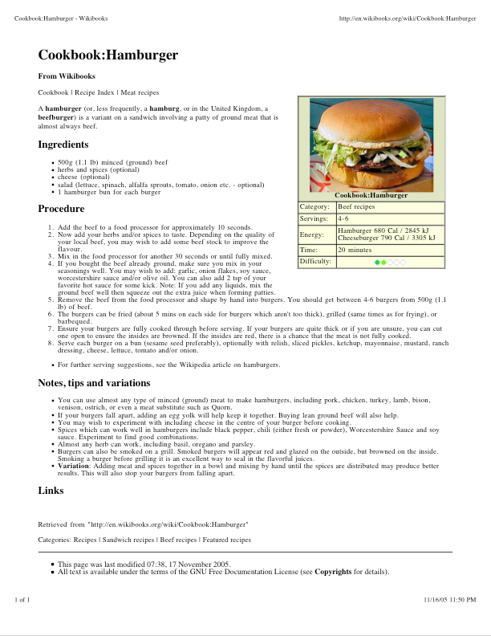

Slide 5
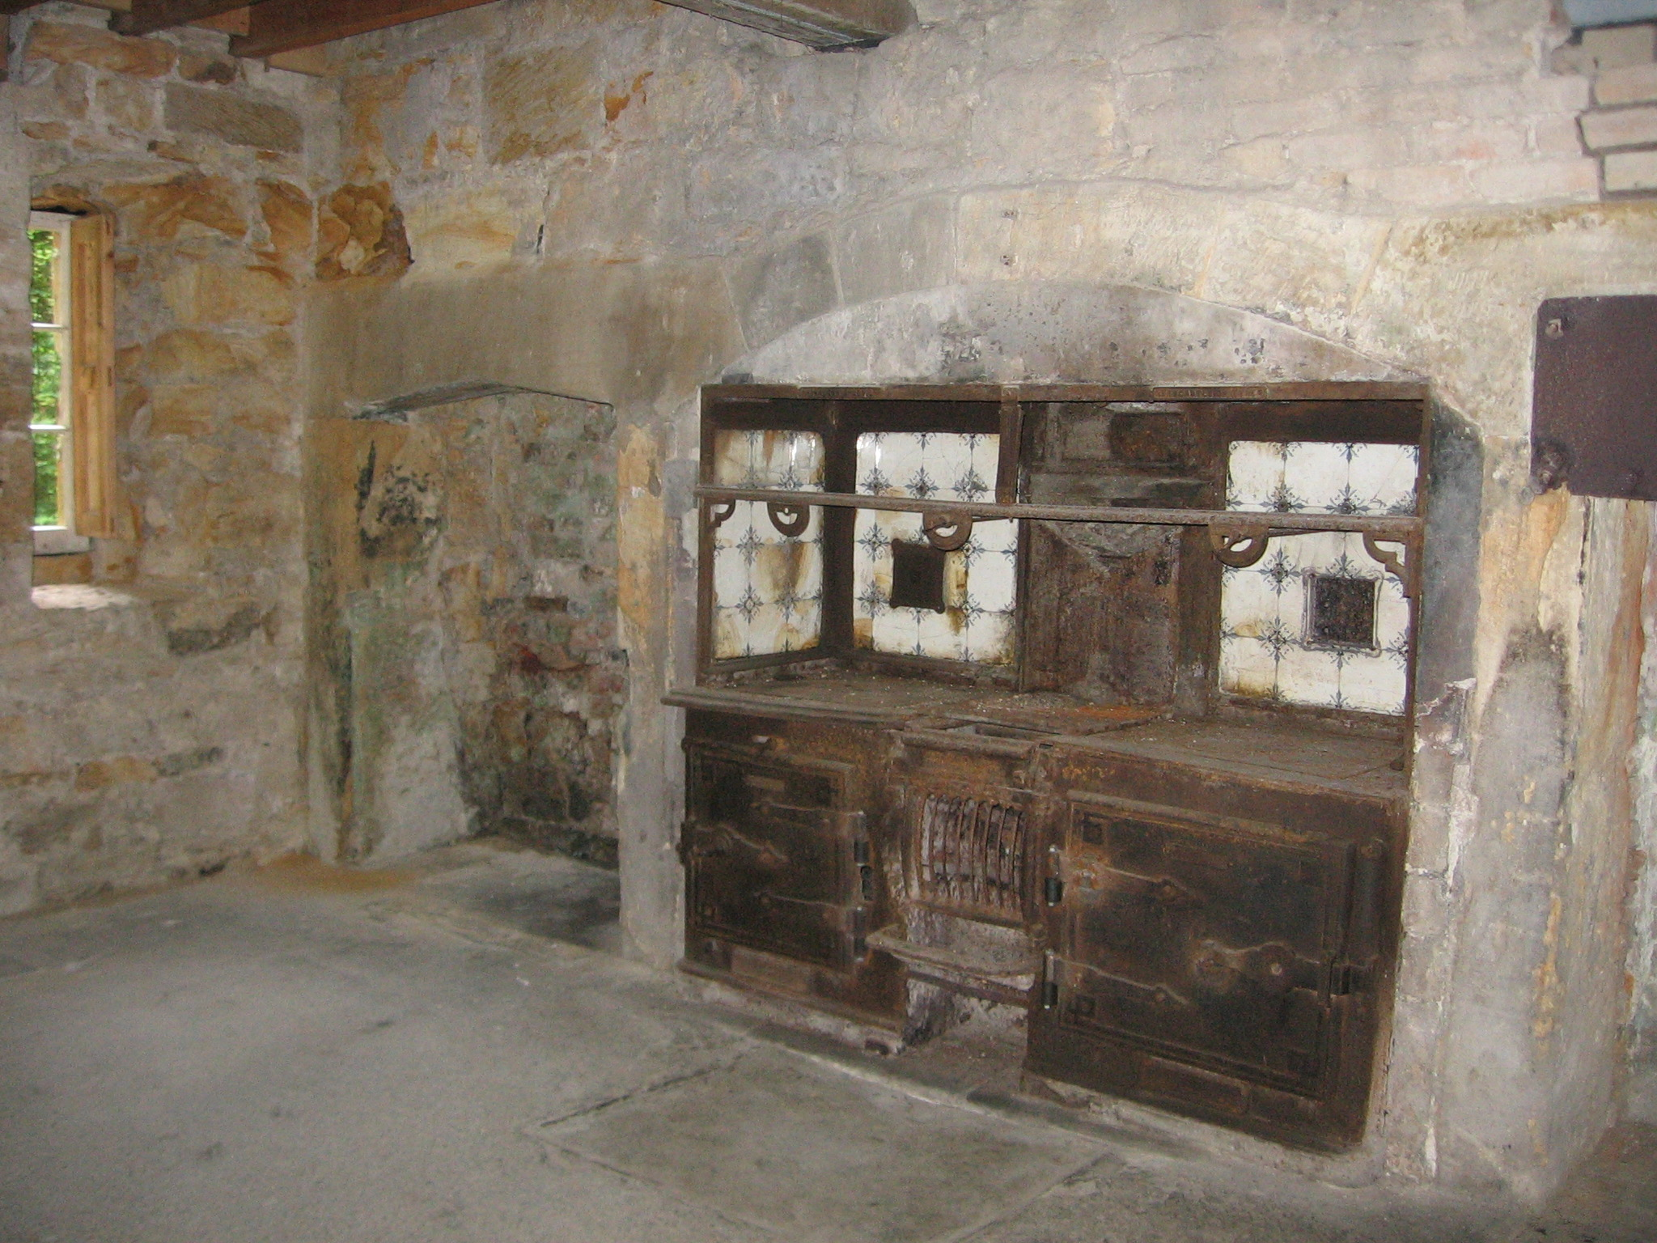

Slide 6


Slide 7


Slide 8


Slide 9
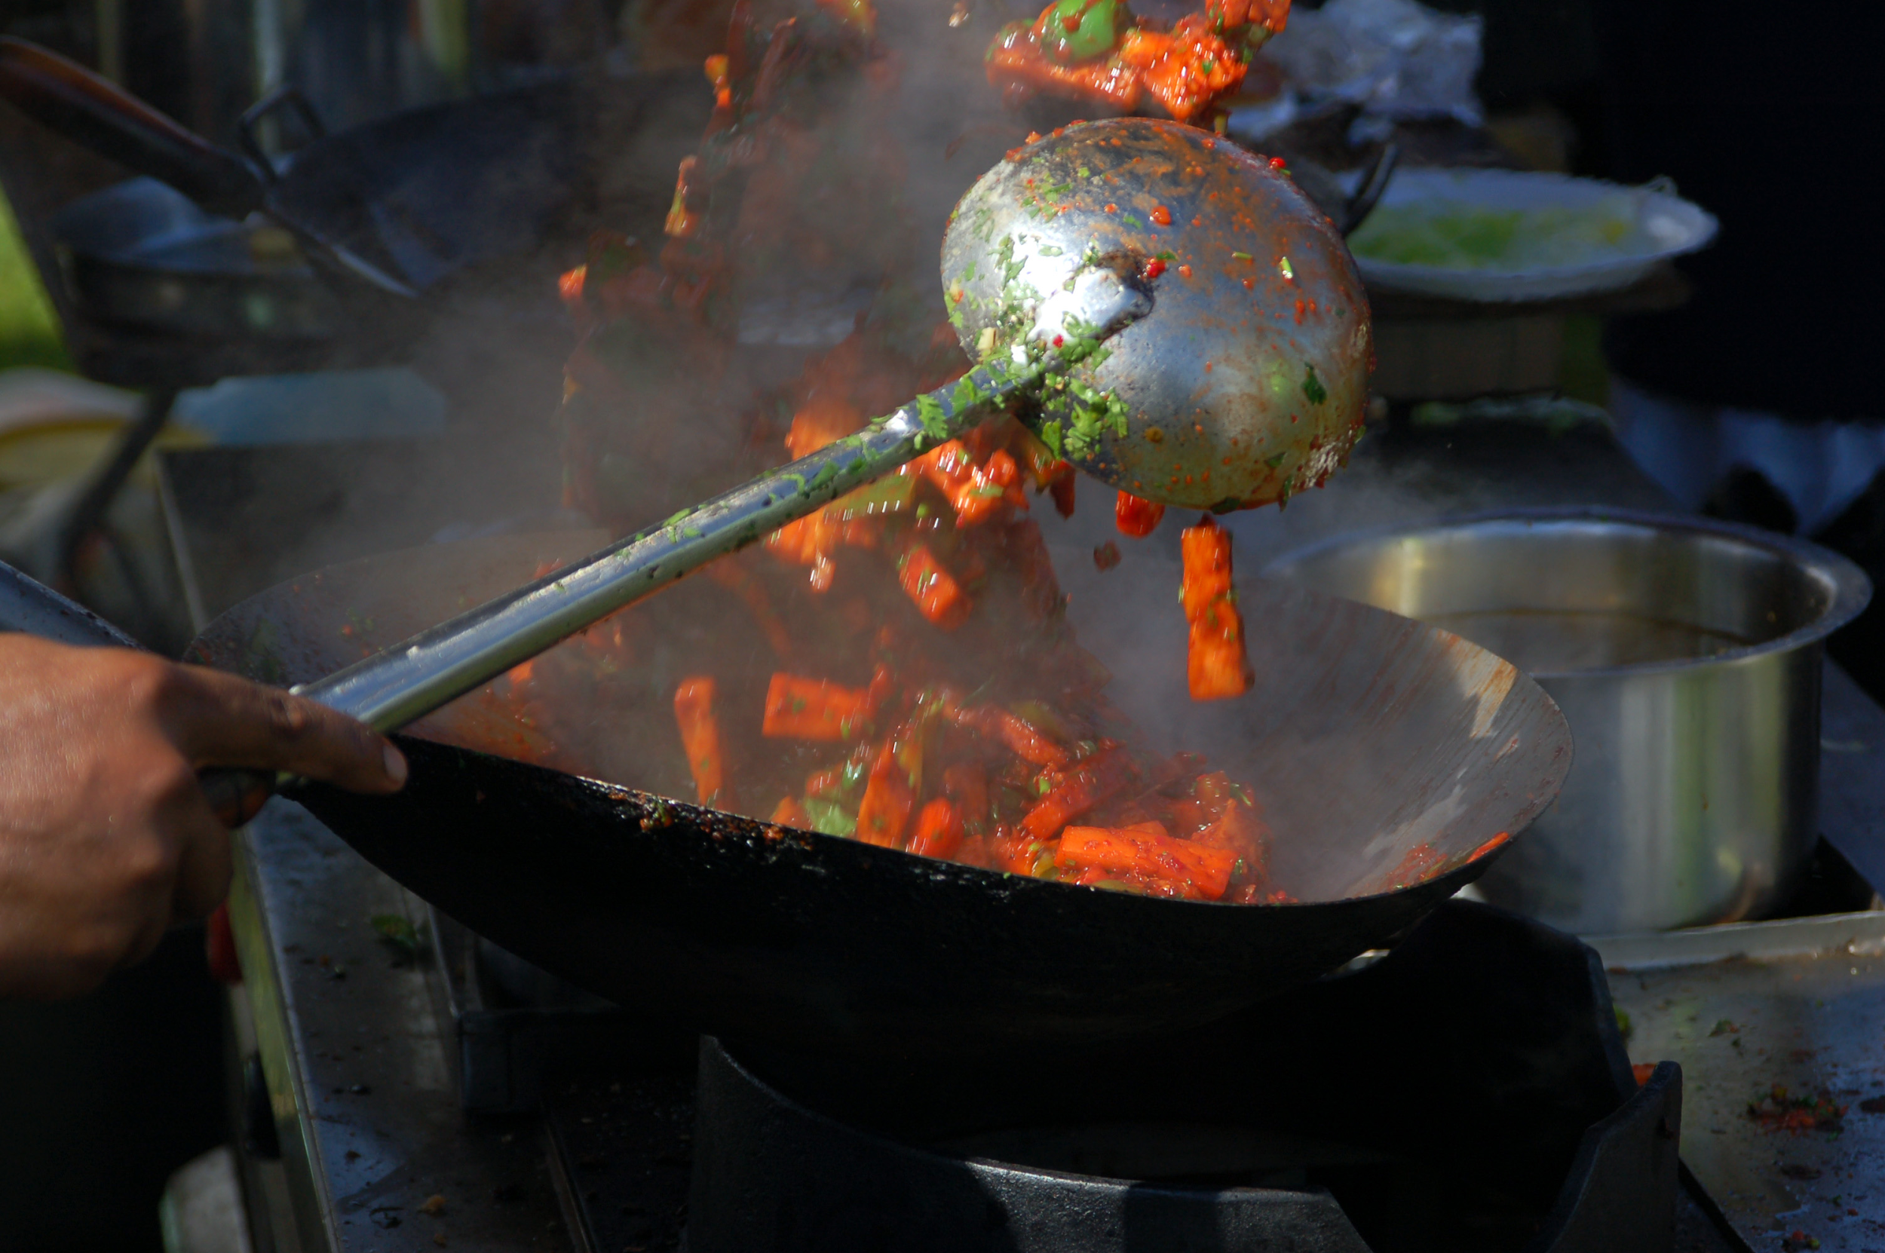

Slide 10
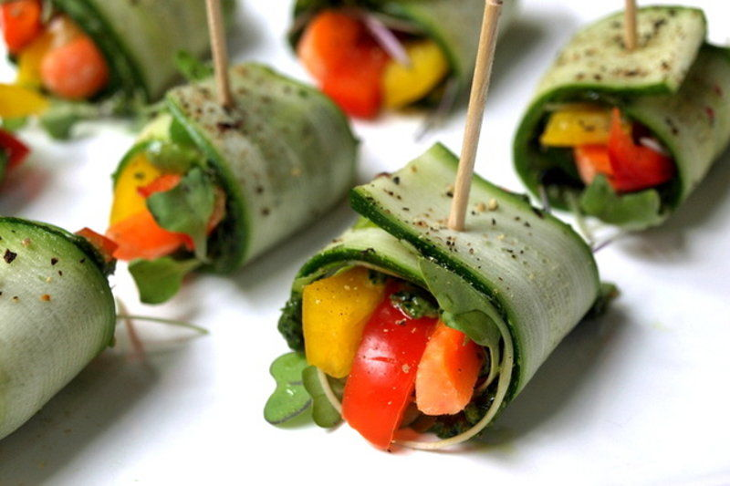

Slide 11

Welcome to Python!

Slide 12
What is Python?

Slide 13






Who uses/used python

Slide 14
What is python used for?
Data Science
Scripting tasks
Searching
Web Applications
Linux operations
server clusters
Many more

Slide 15
What is Python bad at?
Highly abstracted so you lose control compared to C.
Entirely open source so its a pain to create market applications
Not as adopted on platforms such as Android
Harder to optimize
Lower Performance out of the box than compiled languages

Slide 16
Primitives
Integer: numbers without decimals → small memory usage: 1,2,3,4,5
Float: numbers with decimals → take up more space in memory: 1.3333
Long: longer integers → ends with capital L: 12222L
Strings: Words and letters → broken up with quotes (“” OR ‘’): ‘hello’
Booleans: True or False → There’s some argument here...

Slide 17
Data Structures
List: [‘this’,’is’, ‘a’, ‘list’, ‘of’, ‘strings’]
Tuple: (this, is_, a, tuple, of, variables)
Set: {1,2,3,4,5}
Dictionary: {1 : ‘One’, 2 : ‘Two’, 3 : ‘Three’}

Slide 18
Operators
+, -, *, /
=
==
:
Addition, subtraction, multiplication, division
Assignment
Equivalency test
Block scope
def func():
Functions. Same as math. Not entirely true...

Slide 19
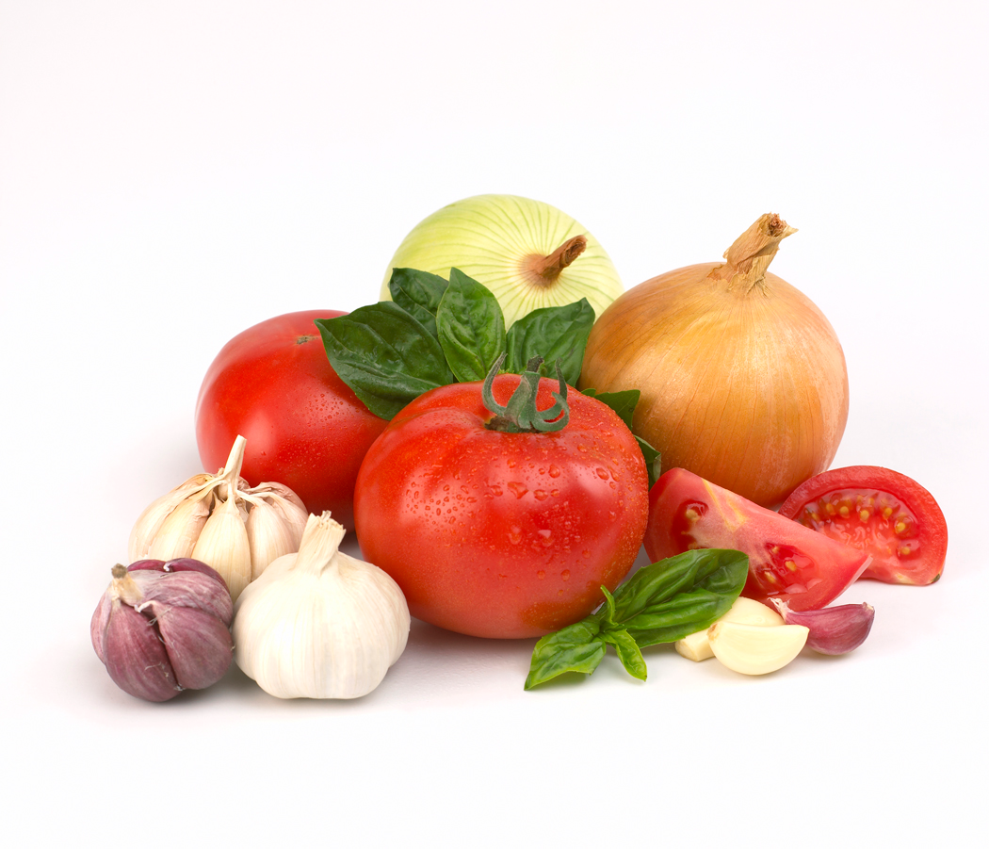


Primitives/Data: ex. Numbers, “strings”
Data Structures: ex. List, Dictionary, Set, Tuple
Operators: ex. Addition, subtraction, concatenation

Slide 20
Now, Here’s your first program...

Slide 21
Hold your breath...

Slide 22
>>print “Hello World.”

